Slide 1

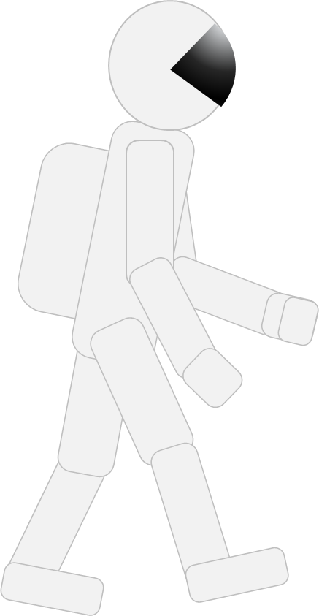
On the Moon
An astronaut is walking on the Moon

Slide 2

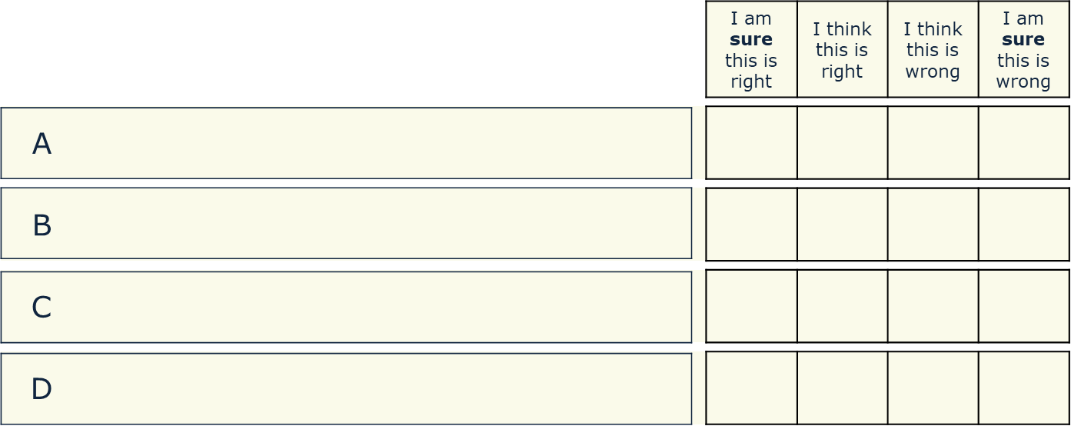
On the Moon
What do you think it is like on the Moon?
There is no gravity because there is no air
Gravity is weaker than on Earth
so she can jump up and down more easily
Gravity is stronger than on the Earth
If the astronaut drops the hammer it will float next to her

Slide 3
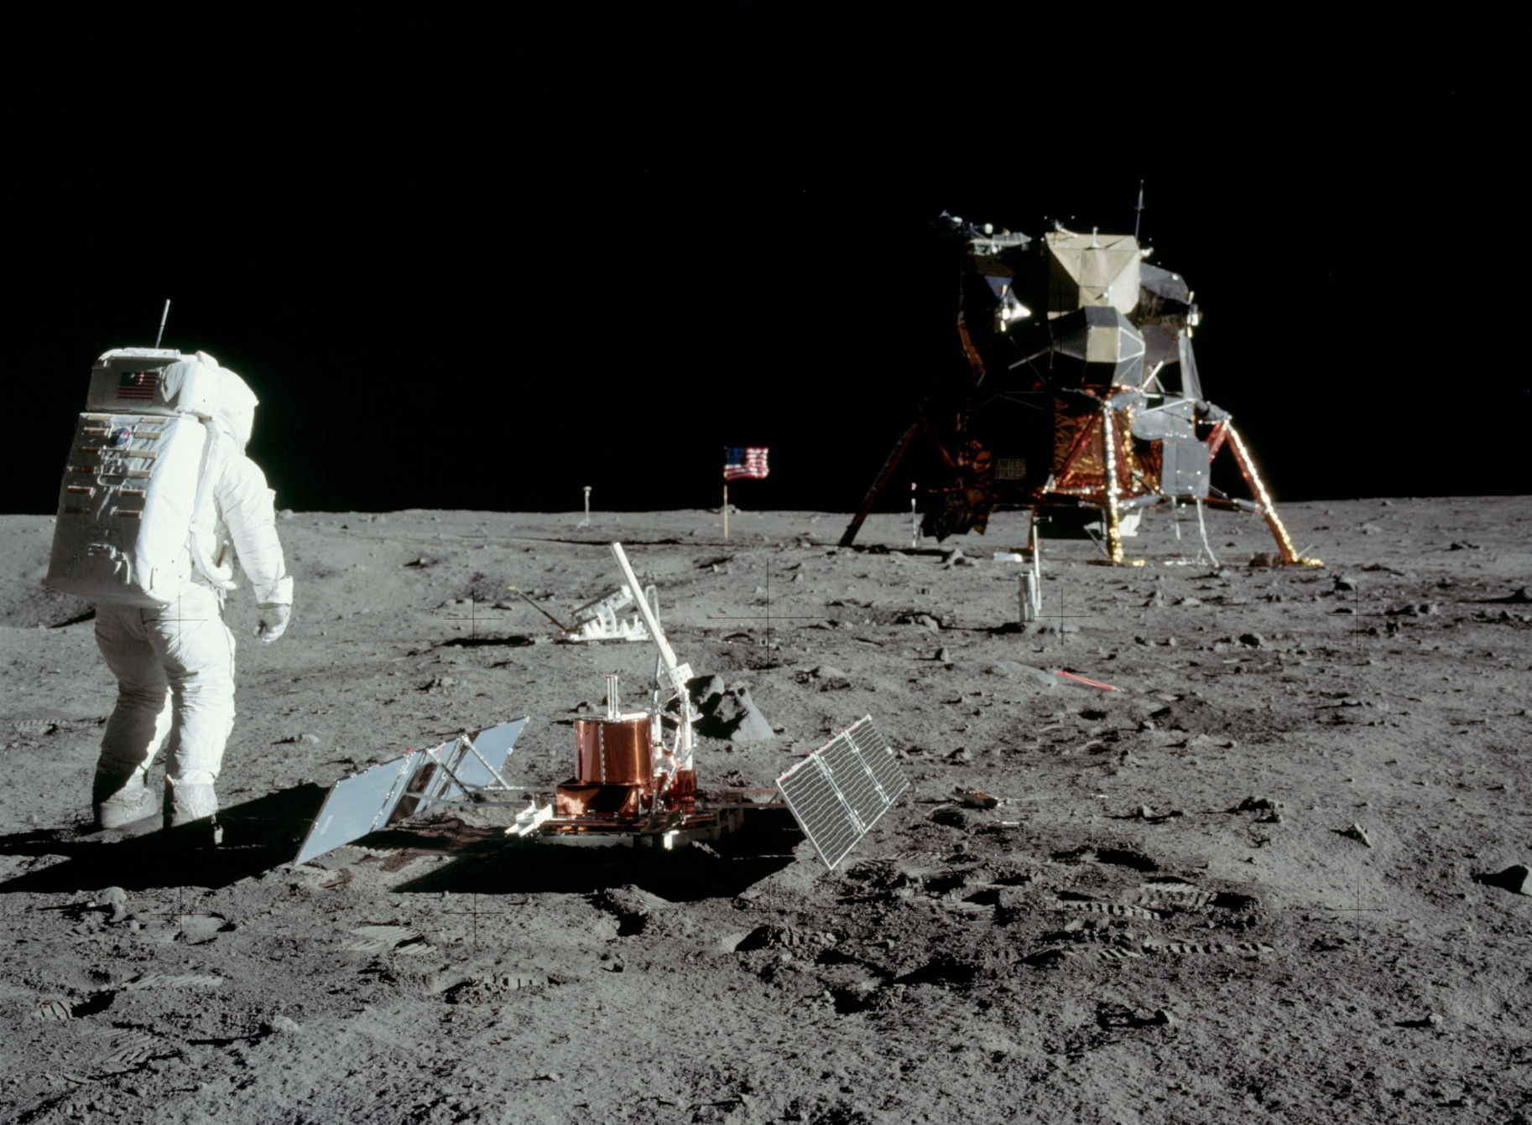
On the Moon
Apollo 11 astronaut, Buzz Aldrin, setting up science experiments on the Moon – July 1969
Notes:
Photo: NASA's Scientific Visualization Studio

